Slide 1
Software Quality
WHAT IS QUALITY?
FOUR DIMENSIONS OF QUALITY
Specification quality
Design quality
Development (software construction) quality
Conformance quality

Slide 2
WHAT IS QUALITY?
To say that a certain product is a quality product implies that the product is of good quality
On the other hand, people certainly use the term bad quality to express their dissatisfaction with the products or services they use
Therefore, the adjective good is implicitly attached to the word quality in the minds of most people
The International Organization for Standardization (ISO 9000, second edition, 2000) defines quality as the degree to which a set of inherent characteristics fulfills requirements

Slide 3
Any product or service that meets the requirements of this definition is rated a “quality product/service”
Any product or service that does not meet the requirements of this definition is rated “poor quality”
Reliability of a product is its capability to function at the defined level of performance for the duration of its life

Slide 4
FOUR DIMENSIONS OF QUALITY
Quality has four dimensions
Specification quality
Design quality
Development (software construction) quality
Conformance quality
Specifications are the starting point in the journey of providing a product or service, followed by design and then development
Conformance quality is ensuring how well that quality is built into the deliverable at every stage

Slide 5
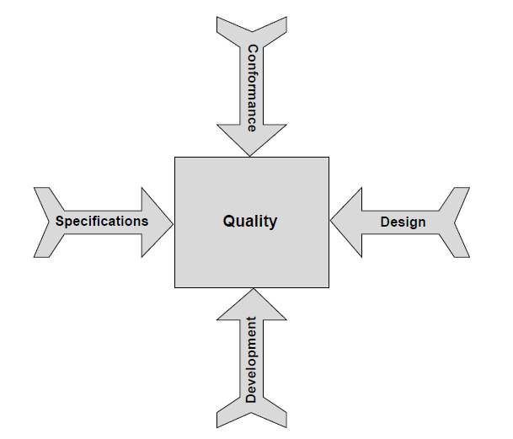

Slide 6
Specification Quality
Specification quality refers to how well the specifications are defined for the product or service being provided
Specifications have no predecessor activity, and all other activities succeed specifications
Thus, if the specifications are weak, design will be weak, resulting in the development and manufacture of an incorrect product, and the effort spent on ensuring that quality is built in will have been wasted

Slide 7
Specifications normally should include the following six aspects:
Functionality aspects : Specify what functions are to be achieved by the product or service
Capacity aspects : Specify the load the product can carry (such as 250 passengers on a plane or 100 concurrent users for a Web application)
Intended use aspects : Specify the need or needs the product or service satisfies
Reliability aspects : Specify how long the product can be enjoyed before it needs maintenance
Safety aspects : Specify the threshold levels for ensuring safety to persons and property from use of the product or service
Security aspects : Specify any threats for which the product or service needs to be prepared

Slide 8
The tools for building quality into specifications are as follows:
Process documentation - Details the methodology for gathering, developing, analyzing, and finalizing the specifications
Standards and guidelines, formats, and templates - Specify the minimum set of specifications that needs to be built in
Checklists - Help analysts to ensure comprehensiveness of the specifications

Slide 9
Design Quality
Design quality refers to how well the product or service to be delivered is designed. The objectives for design are to fulfill the specifications defined for the product or service being provided
Therefore, if the design is weak, the product or service will fail, even if the specifications are very well defined
In terms of software, conceptual design refers to software architecture, navigation, number of tiers, approaches to flexibility, portability, maintainability, and so on
Engineering design refers to database design, program specifications, screen design, report design, etc.

Slide 10
Software design normally contains the following elements:
Functionality design
Software architecture
Navigation
Database design
Development platform
Deployment platform
User interface design
Report design
Security
Fault tolerance
Capacity
Reliability
Maintainability
Efficiency and concurrence
Coupling and cohesion
Program specifications
Test design

Slide 11
It is normal to conduct a brainstorming session at the beginning of a software design project, to select one optimum design alternative and to decide on the overall design aspects
Such as the number of tiers, technology platform, software coupling and cohesion, etc.
A brainstorming session helps designers arrive at the best possible solution for the project at hand

Slide 12
Ensuring Quality in Design
Normally, software design is a two-step process:
Conceptual design - Referred to as high-level design, functional design specification, software requirements specification, and software architecture design
Engineering design - Referred to as low-level design, detailed design specification, software design description, and software program design

Slide 13
The tools for building quality into design include the following:
Process documentation - Details the methodology for design alternatives to be considered, criteria for selecting the alternative for the project, and finalizing the conceptual design
Standards and guidelines, formats, and templates - Specify the possible software architectures along with their attendant advantages and disadvantages and so on
Checklists - Help designers to ensure that design is carried out comprehensively and appropriately

Slide 14
Development (software construction) Quality
The following activities form part of developing software:
Create the database and table structures
Develop dynamically linked libraries for common routines
Develop screens
Develop reports
Develop unit test plans
Develop associated process routines for all other aspects, such as security, efficiency, fault tolerance, etc.

Slide 15
Good-quality construction is achieved by adhering to the coding guidelines of the programming language being used
Normally there is a separate coding guideline for every programming language used in an organization
Coding guidelines contain naming conventions, code formatting that help developers write reliable and defect-free code
Of course, it is very important to have qualified people trained in software development
Construction follows software design, and it should always conform to the design document
In this way, good quality in construction can be achieved

Slide 16
There are two techniques to ensure that quality is built into a product:
Reviews (walkthroughs)
Testing

Slide 17
Conformance Quality
Conformance quality deals with how well an organization ensures that quality is built into a product through the above three dimensions
It is one thing to do a quality job
But it is quite another to unearth any defects lurking in the work product and ensure that a good-quality product is indeed built
Essentially, conformance quality examines how well quality control is carried out in the organization

Slide 18
Ensuring Conformance Quality
Ensuring that conformance quality is at desirable levels in the organization is achieved through :
Audits
Quality measurements
Metrics
Benchmarking
Defect removal efficiency of verification and validation activities, defect injection rate, and defect density are all used for this purpose

Slide 19
Audits also are conducted to ensure that projects conform to various applicable standards for building quality into all activities, including specifications and design
In addition, organizational data is benchmarked against industry benchmarks, and corrective or preventive actions are taken to ensure that organizational conformance is indeed on a par with the industry
Conformance quality is built in through process definition and continuous improvement for all software development activities as well as quality assurance

Slide 20
